Slide 1

Sociology and its emergence

Slide 2

The French Revolution (1789) - Peasants led to dissolution of a social order by movement guided by purely secular ideas – universal liberty and equality.
French society earlier to the revolution had three Estates – Clergy, nobility and the rest of the society (peasants and merchants). These classes were overthrown.
Industrial Revolution (late 18th and 19th century) – set of technical innovations – harnessing steam power to manufacture production and introduction of novel forms of machinery activated by such sources of power.
Industrial revolution – led to mass migration from land to industrial work (labour composition changed). Prior to industrial revolution cities were relatively small but with industrial revolution cities expanded.

Slide 3
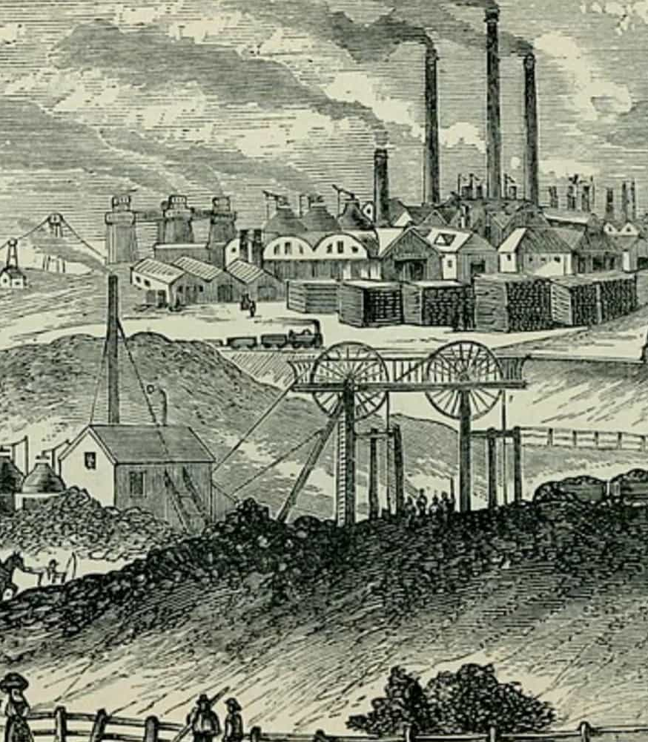
Industrial revolution – led to expansion of cities that led to urbanisation (rapidly expanding urban areas) further leading to problem of slums and other social issues.
Industrial revolution created a capitalist production system where condition of labour under the production system was different from the earlier one and demanded attention.
Capitalistic production also transformed the property relation pushing for accumulation of private property than the common property which was found in societies prior to Industrial revolution.

Slide 4
Sociology, the science of social life, is a discipline of relatively recent origin. It was so named by the French scholar Auguste Comte in 1838, making it a product of the early nineteenth century.
By the time of the birth of sociology in the early nineteenth century, huge changes were taking place across Europe and North America that were having profound effects on the people of that time.
These changes were a result of the industrial and democratic revolutions that occurred at the end of the eighteenth and beginning of the nineteenth centuries.
These changes were rearranging society and changing the way people lived. Society, as people knew it at that time, was undergoing massive transformations.

Slide 5
The introduction of technology and the new economic processes associated with the industrial revolution were altering forever the organisation of societies.
The democratic revolutions (French Revolution) were raising issues about the proper relationship between the individual and society while debating human nature and authority.
‘The changes occurring in society at this time provoked questions about how societies could or should be organised and how emerging forms of society affected relations between groups of individuals in society’ (Hyde et al. 2004:4).
Social change was happening at a rate that had not been seen before and as a result people like Comte saw a need to identify these changes associated with modernity and to chart its likely path.

Slide 6
Sociology emerged as a new discipline only in the first half of the 19th century, as a response to the crisis caused by the French and the Industrial revolutions.
The social, economic, political and intellectual background of the 18th century Europe facilitated the emergence of sociology. It emerged in European society corresponding to its socio-historical background which had its origin in the Enlightenment period.
The Enlightenment period stretched from 14th to 18th century and had given rise to force of social change which rocked the feudal monarchy and church in Europe.
Similarly, the Industrial Revolution in England brought about deep-rooted changes in the nature of society and role of individual in the society.

Slide 7
It gave rise to varieties of social and cultural problems. All these developments provided the requisite impetus to the scholars and thinkers of that period to develop a science of society which could address these problems.
Comte famous book “Positive Philosophy”, Comte pointed out the need for the creation of a distinct science of society which he first called “Social Physics” and later “Sociology” that should concern itself with an analysis and explanation of social phenomena.
Auguste Comte coined the term Sociology in the year 1838. The word “Sociology” has been derived from two words i.e. the Latin word “Socius “ or “Societus” meaning society, companion or associate and the Greek word “Logos” meaning “study” or “science” Hence, the etymological meaning of the term sociology is the science of society or the study of society.

Slide 8
The two epoch-making events French Revolution and Industrial revolution changed the entire history of human society.
It resulted in metamorphic changes in the realm of economy, polity, culture and religiosity of mankind. This altered reality attracted the attention of the scholars like Saint Simon, Auguste Comte and others. They attempted to explain this social transition thereby envisioning their ideas on social reconstruction.
Sociology owes its birth to this intellectual endeavour.

Slide 9
Sociology
According to Barry and Yuill (2002) - ‘Sociology is concerned with the study of society and specifically with key issues such as explaining change and the distribution of power between different social groups’.
Sociologists attempt to:
understand how society works, and
explain why people do the things they do, in the way that they do them.
Central concern of this discipline of sociology is the study of the relationship between individuals and society, i.e. how people act and impact on the society they live in and vice versa (Hyde et al. 2004:5).

Slide 10
Scope and Subject matter of Sociology
Scope means area of study, field of inquiry or the subject matter. Each subject has its own field of study, so also sociology.
Study of sociology is organized within a specific boundary which is known as the scope of sociology. Without a demarcated boundary, it is very difficult to study a subject systematically.
Hence, it is necessary to demarcate the boundary or scope of a subject. There are two main schools of thought among sociologists on the issue of scope and subject matter of sociology:
Formal school or specialistic school of thought and
Synthetic school of thought.

Slide 11
Formal school or specialistic school of thought
This school of thought is headed by German sociologist George Simmel. Alfred Vierkandt, Leopold Vonwiese, Max-Weber, Albion Small, Ferdinand Tonnies, E.A. Ross, Park and Burgess are other important supporters of this school.
Formalistic school is headed by German sociologist George Simmel.
According to this school of thought the subject matter of sociology consists of this school opine that sociology cannot study social life as a whole. Hence, the scope of sociology is very limited. They want to keep the scope of sociology distinct from other social sciences.
They consider sociology as a pure and independent science.

Slide 12
George Simmel:
According to Simmel sociology should confine its study to formal behaviour instead of studying actual behaviour.
Sociology comprehends the forms of social science which describes analyses, classifies and delineates the forms of social relationships, the process of socialization and social organization etc.
Simmel makes a distinction between the forms of social relationships and their contents and opines that sociology should confine itself in explaining different forms of social relationships and study them in abstraction whereas their contents are dealt with by other social sciences.
Co-operation, competition, sub-ordination, division of labour etc. are different forms of social relationships. As sociology confines itself in studying forms of social relationships, its scope is very limited.

Slide 13
Alfred Vierkandt
Another leading supporter of formal school Vierkandt opines that sociology is a special branch of study which deals with the ultimate forms of mental or psychic relationships.
These mental relationships consist in love, hate, co-operation etc. which shape particular types of social relationships. He maintains that sociology can be a definite science only when it abstains from a historic study of concrete societies.
Thus, in his opinion the scope of sociology is very limited as it deals with the ultimate forms of mental or psychic relationships like love, hatred, co-operation, competition etc.

Slide 14
Max Weber
Another supporter of formalistic school Max Weber opines that the aim of sociology is to attempt an interpretative understanding of social action and classification of social action and social behavior.
It should confine itself in the analysis and classification of social action and social behaviors.
Social behavior is that which is related to the behavior of others. As social behavior does not include the whole of human relations, hence the scope of sociology is very limited.

Slide 15
Synthetic School
It came into existence in reaction to the formalistic school of thought. It tries to make sociology a synthesis of the social sciences or a general science and encyclopedic.
According to this school of thought, the scope of sociology is very wide and all inclusive.
According to this school of thought, different aspects of social life are inter-related. We can’t understand society with the study of one aspect only; hence sociology should attempt to study social life as a whole. Sociology studies the whole of social life; hence its scope is very wide.
The main advocates of this school of thought are Emile Durkheim, L.T. Hobhouse, P.A. Sorokin, Morris Ginsberg, Karl Mannheim, Alex inkles and many others.

Slide 16
Emile Durkheim
The main advocates of synthetic school Durkheim opines that the scope of sociology has three main divisions or field of study.
Social Morphology: It includes all those subjects which are fundamentally geographic, such as, population, its size, density, distribution, mobility etc. This comprehends two studies. First, analysis of the size and quality of the population in as much as it affects the qualities of social relationships and social groups. Second, study of the social structure, or a description of the main forms of social groups of institutions as well as their classification.
Social Physiology: Social physiology is inclusive of all those subjects that are studied by particular social sciences, such as religion, economy, language, morals, law etc. In other words, social physiology has different branches, such as sociology of law, sociology of religion etc. which are regarded as special aspects of sociology.

Slide 17
Emile Durkheim
General Sociology: General sociology is the philosophical part of sociology. Its function is to discover the general character of these social facts and to formulate general social laws.
P.A. Sorokin
Sociology studies various aspects of the social relationships hence can’t be called as a special science. He also subscribes the view that sociology is a synthesis of the social sciences or a general science.
According to him, the scope of sociology includes the study of general features of social phenomena and the study of relationship between the different aspects of social phenomena

Slide 18
Karl Mannheim:
Another supporter of synthetic school of thought Karl Mannheim opines that the scope of sociology is very wide.
He divides sociology into two categories such as systematic and general sociology and historical sociology.
Systematic and general sociology deals with main factors of living together found in different kinds of society whereas historical sociology deals with the historical variety and general forms of society.
Subject Matter of Sociology: Subject matter means scope, area of study or field of inquiry. Every subject has its own subject matter so also sociology. Study of sociology is organized within a specific boundary which is known as the scope or subject matter of sociology which is already discussed in the above slides.

Slide 19
Nature of Sociology
Sociology is a Science: According to Comte and Durkheim, “Sociology is a science because it adopts and applies the scientific method. Sociology does make use of scientific methods in the study of its subject matter. Hence Sociology is a science. It is a science because of the following reasons.
Sociology pursues scientific method: Sociology studies social reality with the application of scientific method. It believes that human action can be subject to scientific investigation like natural phenomenon
Sociology uses observation as a tool: Sociologist studies social world as a social observer. The whole world is the laboratory of sociology. The sociologist applies fieldwork method in the understanding and interpretation of the human world

Slide 20
Nature of Sociology
Objectivity is possible in Sociology: Like natural sciences, Sociology engages itself in objective analysis. Sociological insights are based on facts emerging from field investigation.
Sociology makes accurate measurement: Sociology, like natural sciences also accurately measures social phenomena or relationships. By using statistical method, socio-metric scale, scales of measurement sociology effectively and accurately measures social relationships. Hence Sociology is a science.
Prediction is possible: Like natural sciences, sociology does frame laws and attempts to predict more accurately. Based on cause-effect relationship, sociology can accurately predict about future. If there will be dowry in society then it will lead to suicide, poverty. Cuvier opines that this predictive value of sociology is improved day by day. As Sociology matures day by day, it predicts more accurately.

Slide 21
Nature of Sociology
Generalization is possible: The notion that generalisation drawn by social sciences is not universal is proved wrong. Like natural sciences, sociology draws generalizations based fieldwork which is universally applicable. The concept of incest taboo-prohibited sex relationship among blood relatives is a universal truth
SOCIOLOGY IS NOT A SCIENCE: There are some scholars like Max Weber who deny the status of science to Sociology. He said Sociology can’t be an objective Science. However, those who deny the status of science to Sociology they put forth following arguments:
Lack of Objectivity
Lack of Experimentation
Lack of Prediction
Lack of accurate measurement

Slide 22
Nature of Sociology
SOCIOLOGY IS NOT A SCIENCE:
Lack of accurate measurement
Lack of Generalisation
Terminological Inadequacy
Famous Sociologist Robert Bierstedt in his book “The social order” clearly explains the nature of Sociology in the following way:
Sociology is a social and not a natural science
Sociology is a pure science and not an applied science.
Sociology is an abstract science and not a concrete science.
Sociology is a generalizing science and not a particularizing science.
Sociology is both a rational and an empirical science

